Slide 1
Raytracing
Rutger van den Berg - 4060156
Ymte Jan Broekhuizen – 4246586
Qu Chen – 1256025
Arend Jan de Graaff – 4012534
Max Groeneboom – 4169298
Rick van Hattem - 1297295
Ewoud van der Heide – 1534033
Leon Hoek – 4021606
Vince Kasanpawiro - 4028880

Slide 2
COMPETITION IMAGE TBD
COMPETITION IMAGE TBD

Slide 3
WORK DISTRIBUTION
Rutger: Debugging Linux, reflection, made sphere model
Ymte Jan: Octree, multithreading, old RealTime RayTracing, shadows, added movement of model through WASDEQ keys, added ground textures, Phong shaders
Qu: Debugging Visual Studio, Ray-Sphere Intersection, made slides
Arend Jan: Debugging Visual Studio, made a branch, and removed a line
Max: Ray-Sphere Intersection, Ray-Triangle Intersection, debugging Visual Studio, made Sierpinski Pyramid model, made UglyThing model, made cube model, shadows, old FPS counter
Rick: Multithreading, downloaded simplemonkey model, debugging McOS, hosted git, timer, rewriting galore, background raytracing, , current FPS counter, current RealTime RayTracing
Ewoud: Colours, made beer bottle model
Leon: Octree, debugging Linux
Vince: Made Diamond model, made slides, debugging Visual Studio

Slide 4
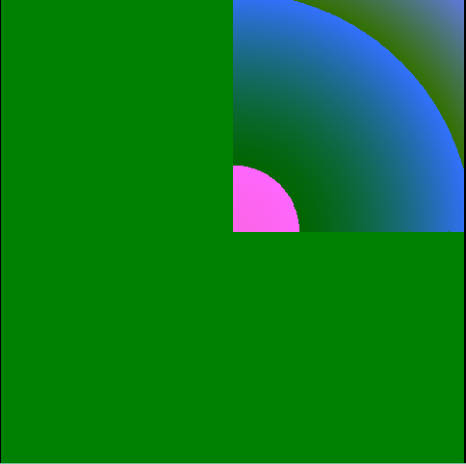
Psychedelic Art

Slide 5
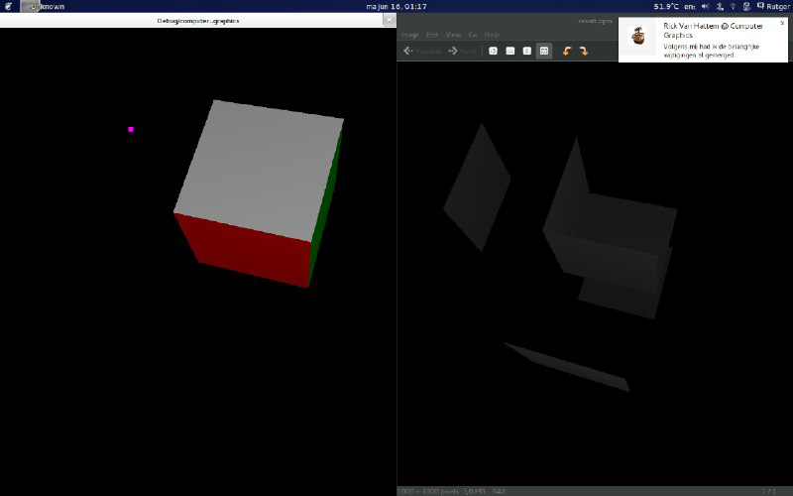
Our previous iterations

Slide 6
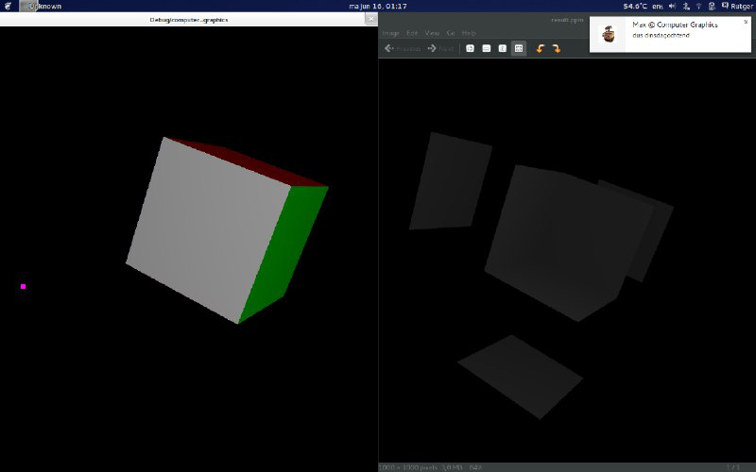

Slide 7
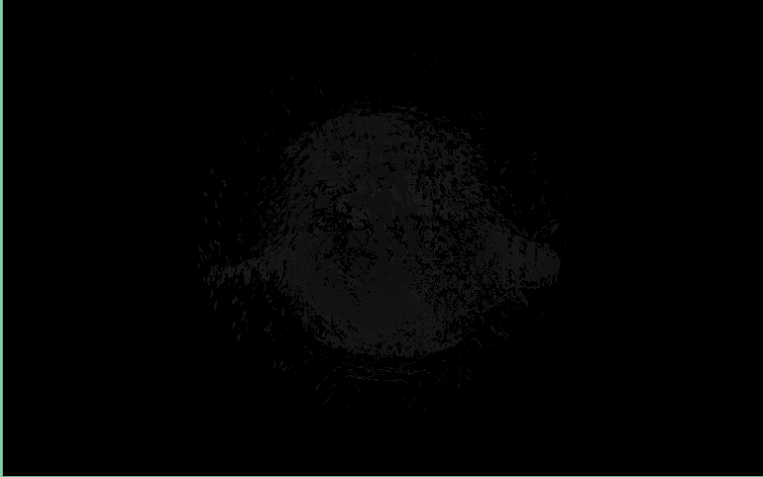
Monkey, not there yet.

Slide 8
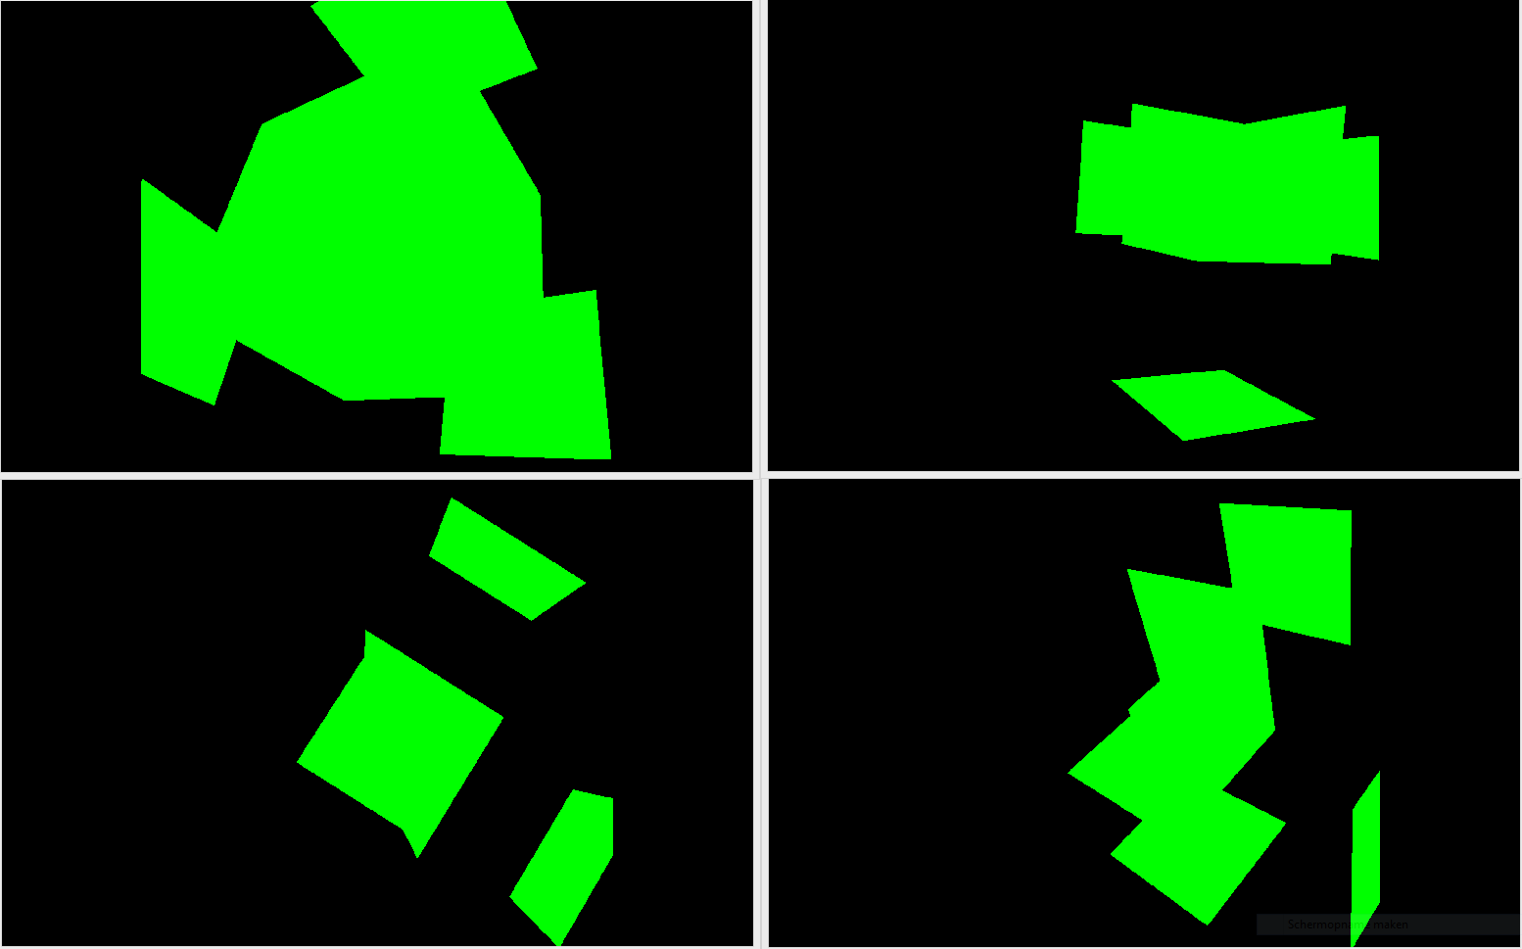
A slight problem with Cube

Slide 9
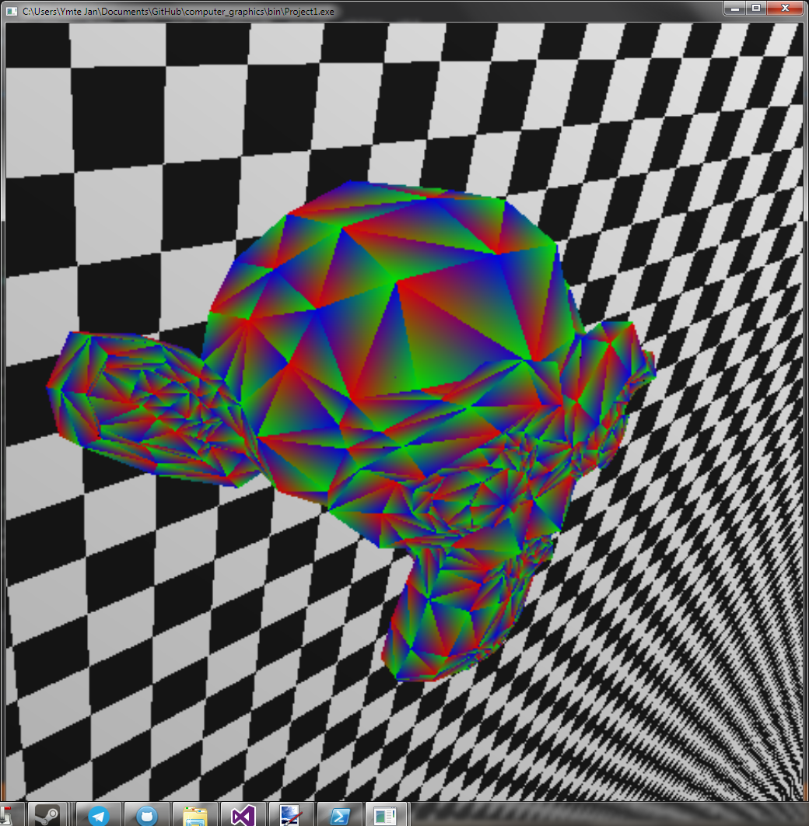
Trying to implement Blinn-Phong: using the normals as colors for the mesh

Slide 10
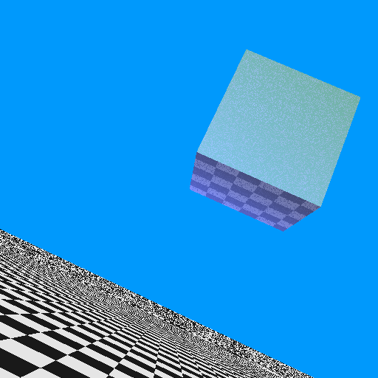
Reflection!

